Slide 1
Alexander graham bell

Slide 2
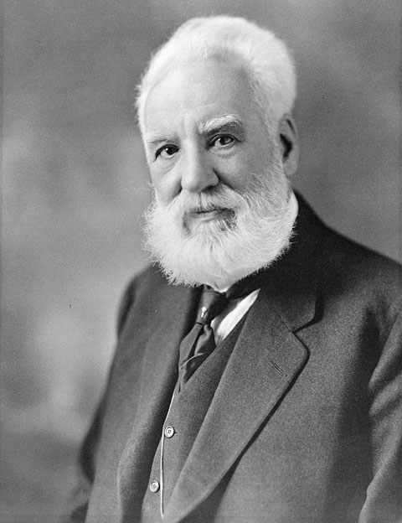
Alexander Graham Bell
Alexander Graham Bell invented telephones.

Slide 3
Alexander Graham Bell
Alexander Graham Bell was born on March 3 1847 in Scotland

Slide 4
Alexander Graham Bell
Alexander Graham Bell's mother and wife were deaf.

