Slide 1
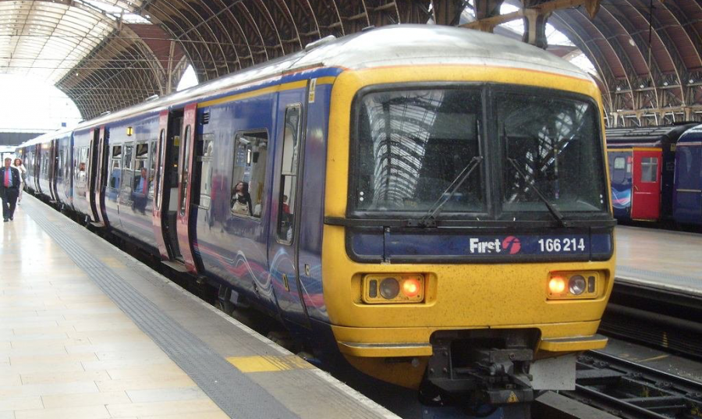
Trains

Slide 2
Trains
A train is made up of an engine and carriages or trunks.
Trains are used to carry passengers and cargo along railway tracks.
Today, trains are mostly powered by electricity or diesel.
But when was the train first invented??

Slide 3
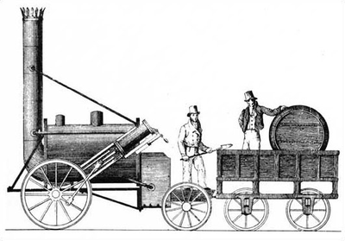
History of Trains

Slide 4
History of Trains
In the mid-1500’s, railways were used for work purposes to carry wagonloads of coal and other heavy items.
The wagons ran on parallel wooden planks and then on iron rails.
The job of pulling these heavy loads was done by people or horses.

Slide 5
History of steamtrains
Thomas Savery was the 1st person to invent a steam pump to pump out water in 1698.
The earliest trains needed horses to guide it along the track.

