Slide 1
Engineers week
By Chloe.

Slide 2
Computer engineers.
Computer engineers make computers faster, smaller, cheaper, and smarter.

Slide 3
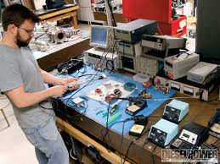
Electronical engineer.
An electronical engineer is someone who designs and develops new electrical equipment and solves problems.

Slide 4
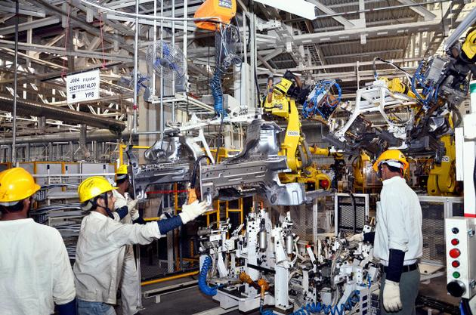
Mechanical engineers.
Mechanical engineering is concerned with the design, maintenance and development of machines and equipment.

Slide 5
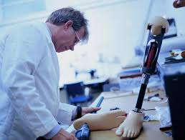
Biomedical engineer.
Biomedical Engineering is a relatively new branch of engineering that involves the use of cutting-edge technologies to help improve human healthcare.

Slide 6
Chemical Engineer.
A chemical engineer is a engineer that works with chemicals.

Slide 7
Civil engineer
A civil engineer builds bridges roads and big buildings. They also plan all the things before they are built.

Slide 8
Environmental engineer.
Environmental engineers focus on projects related to natural resources rather than man-made projects.

Slide 9
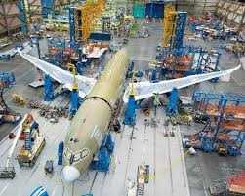
Aeronautical Engineer.
Aeronautical engineering is about how aircraft are designed, constructed and powered, how they are used and how they are controlled for safe operation.

Slide 10
Thanks for watching and listening

