Slide 1
Creations.
Jack Jones and John Gormley.

Slide 2
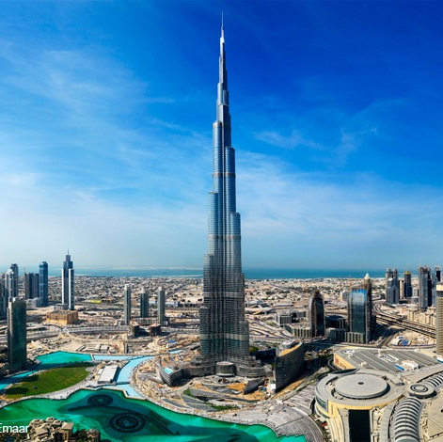
The Burj Khalifa.
The Burj Khalifa is the tallest building in the world, standing at 828m tall, it was built in Dubai in the year 2004.

Slide 3

Steve Jobs
Steve Jobs was the creator of a multi-national company. His company, “Apple” makes technology such as: phones, laptops, computers and more!

Slide 4
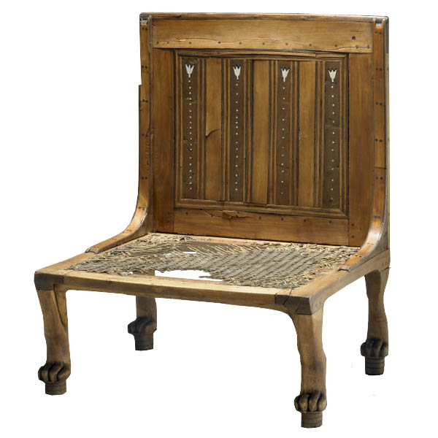
The chair.
The ancient Egyptians created the chair in 2,860 B.C. the first evidence was found in a tomb where a wooden, four-legged piece of furniture was found.

Slide 5
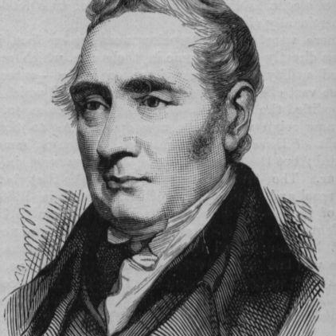
Richard trevithick.
It was Richard Trevithick that invented the 1st train and he did it in 1804. During his childhood he loved to mine and he always wanted to be an engineer.

Slide 6
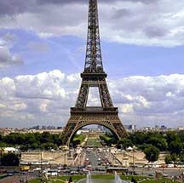
The eiffel tower.
The Eiffel Tower was built in 1889 and it is and was one of the most beautiful monuments in the world.

Slide 7
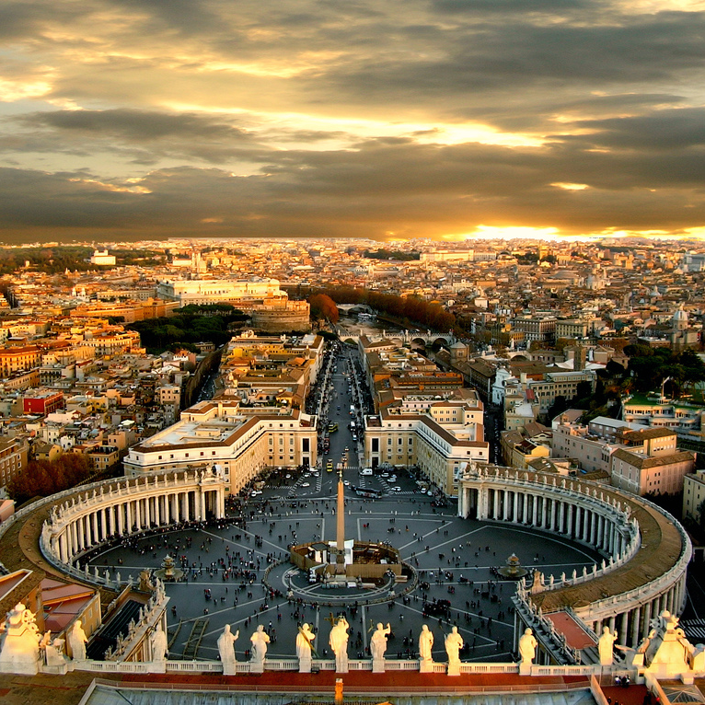
The vatican.
The Vatican is where the pope lives and it’s counted as it’s own country. This is a really holy place although it has one of the highest crime rates in the world.

Slide 8
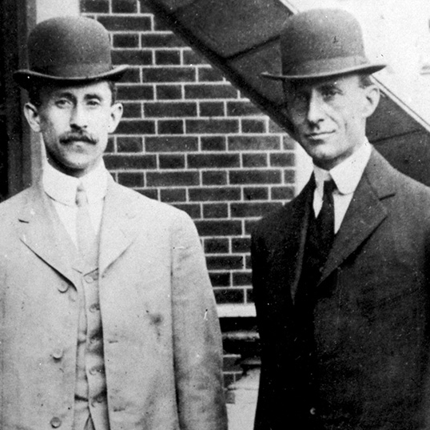
The wright brothers.
The Wright brothers were two famous brothers that made air-flight possible by creating the very 1st aircraft in 1903.

Slide 9

The television.
In 1927 the television was invented and this was a major invention so people can see what goes on around the world and can keep themselves entertained.

Slide 10

All inventions.
Every invention that was ever made was an important edition to the people of the world.

