Slide 1
The renaissance
By Shane & Róisín

Slide 2
It represents a cultural rebirth from the 14th through the middle of the 17th centuries.during the Early Renaissance mostly in Italy, bridges the art period during the fifteenth century, between the Middle Ages and the High Renaissance in Italy.

Slide 3
The Renaissance began in Florence that is a place in France

Slide 4
The renaissance took place from the 1300-1700.
It's a movement that began in Florence in the late 13th century. Historians have pinpointed Florence as the source of the beginning of the ideas that led to the Renaissance, including the writings of poet Dante Alighieri and Francesco Petrarca, the scholar, poet and humanist.

Slide 5
King Philp IV of France got the pope arrested and made him a prisoner . That made people stop thinking about the after life.

Slide 6
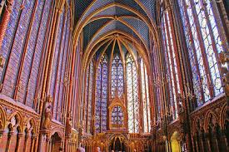
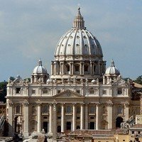
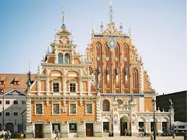
These are a few pictures of art and architecture from the time of the Renaissance.

Slide 7
These are four very important people from the Renaissance.
Michelange Niccolo Machiavelli was an Italian writer, historian, diplomat and humanist. Moving in political circles, he created a new branch of political science based on humanist principles. His greatest work, The Prince is an expose of political machinations.
Thomas More was an English statesman who wrote an ideal political system, Utopia. He was considered a social philosopher and Renaissance humanist. He was executed for refusing to accept Henry VIII as head of the Church of England.
Michelangelo is widely regarded as the most famous artist of the Italian Renaissance. Among his works are the "David" and "Pieta" statues and the Sistine Chapel frescoes.
Leonardo da Vinci was a leading artist and intellectual of the Italian Renaissance who's known for his enduring works "The Last Supper" and "Mona Lisa."

Slide 8
The Renaissance led to significant results. It brought about a transition from the medieval to the modern age.
This period witnessed the end of the old and reactionary medieval spirit, and the beginning of the new spirit of science, reason and experimentation.

